Slide 1
Anomalous Traffic Prediction
Kaiyue Zhang, Wei Zheng, Tong Wu

Slide 2

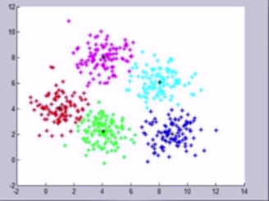
Clustering
Unsupervised learning
Find structure and similarity among the dataset

Slide 3
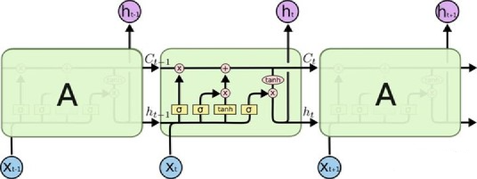
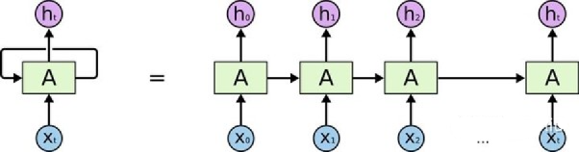
LSTM (Long Short Term Memory)
Predict the probability from a single data or a sequence of data
Solve the long-term dependency problem

Slide 4
Related Works
Using K-means algorithm to get the anomalous data set[1]
15% anomalous traffic do not direct to unusual destination port
Using K-means algorithm to detect anomalous traffic[2]
Relatively false alarm rate
Using LSTM autoencoder to detect network anomalous[3]
Hard to get balanced data

Slide 5
Questions
How to make the detection method more precise and have lower false alarm rate?
How to make the detection method can detect large amount of data in real time?
How to provide a balance dataset to avoid naïve behaviour?

Slide 6
Reference List
[1] G Munz, S Li, G Carle. Traffic Anomaly Detection Using K-Means Clustering
[2] M Jianliang, S Haikun, B Ling. The Application on Intrusion Detection Based on K-means Cluster Algorithm
[3] M S Elsayed, N Le-Khac, S Dev, A D Jurcut. Network Anomaly Detection Using LSTM Based Autoencoder

